Slide 1
Learning to learn
Focus
A seminar series on the
strategies behind effective learning.
...and avoid distraction
An In Beta project
Find out more here.

Slide 2
Myths about learning
You are not a multitasker; no-one can multitask. You’re task switching, and paying a cognitive cost every time.
Following something (when re-reading it) is not the same as understanding it. We trick ourselves into the Illusion of knowledge.

Slide 3
Facts about learning
Rereading and massed practice are popular but ineffective.
Good learning is active learning;
Active learning means working smart and hard;
Working smart and hard is difficult and takes effort.

Slide 4
Deep work vs Shallow work
Deep work: Professional activities performed in a state of distraction-free concentration that pushes your cognitive capabilities to their limit e.g. synthesising information from multiple sources, solving complex problems.
Shallow work: Not cognitively demanding, logistical-style tasks, often performed while distracted e.g. email, formatting notes, underlining text.

Slide 5
Why focus on focus?
Focusing is about being able to concentrate intensively on a single task for long periods of time, avoiding distractions so that you can master skills quickly.
Information consumes attention. The more incoming information you have to attend to, the less attention you have for each source. If you want to have more focused attention, you need to cut down on incoming information.

Slide 6
Flow (a state of focused attention)
Characterised by being completely absorbed in the task at hand.
Happens when tasks are challenging but not so difficult that you can’t complete them.
Don’t aim to achieve flow states but notice when you’re in one, as you may need to increase the challenge.
Note: Some suggest that learning difficult subjects requires a level of difficulty that makes achieving a flow state impossible.

Slide 7
Improving your ability to focus
Mindfulness is a meditation practice that helps to improve your ability to focus.
Delayed gratification (or cognitive control) is the ability to put off until later, something that you really want to do now.
Get comfortable with the period of discomfort that precedes distraction. It usually only lasts about 10 minutes.
Start small. Aim to focus for 10 minutes.

Slide 8
Challenges with focusing your attention
Failing to start (i.e. procrastinating). Recognise when you’re procrastinating. “I just need to check [...] quickly.”
Sustaining your focus (i.e. avoiding distraction). Quality and duration of the session.
Failing to create the right kind of focus. Arousal and task complexity.
There are too many Things. See the Pareto principle.

Slide 9
Sources of distraction
Your environment: How many tabs do you have open? Are you online? Are your phone notifications turned off (even better: Is your phone in the other room)? Do you have everything you need to complete the task?
Your task: What format is more distracting for you? Do you have to re-read the same paragraph multiple times? Solve problems or make notes?
Your mind: Are you dealing with relationship issues? Are feeling restless (go for a walk)? Are you angry about something? Let it rise, notice it, let it go.

Slide 10
Environmental changes to encourage focus
Disable all phone and computer notifications. It really can wait.
Become hard to reach.
Quit social media. See Continuous partial attention.
Work in a quiet place. Library or private space.
Work at a quiet time. Early morning is better than late at night.
Limit internet access. Start with everything you need.

Slide 11
Tips for avoiding distraction
How you spend the first 10 seconds will determine how you spend the next hour. Get a good start.
Make it hard to be distracted.
Recognise when you’re getting distracted (it’s usually preceded by a feeling of discomfort).
Use time blocking e.g. “For the next 1 hour I’m going to focus on [...].” But this is meaningless if you don’t actually do the work.

Slide 12
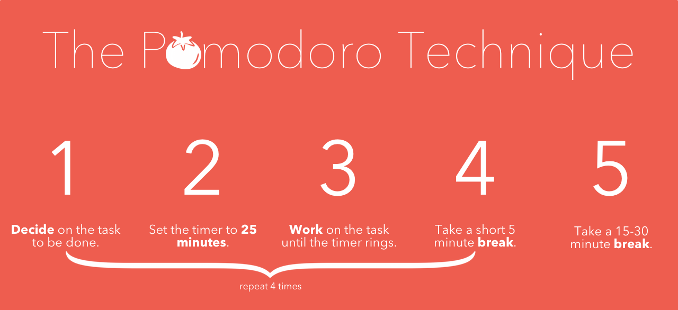

Slide 13
Know when to stop (i.e. have downtime)
Downtime gives you space for new insights.
Downtime helps to recharge your ability to focus.
Evening work tends not to be high quality.
Don’t take breaks from distraction; take breaks from focus.

Slide 14
Move towards resistance and pain, your best-self is on the other side.

Slide 15
Tools for improving your focus
Getting Things Done framework
Mobile apps you may find useful
Pomodoro timer (focused concentration)
Headspace, Waking up, 10% happier (meditation)
Forest (avoiding your phone)
Airplane mode (no notifications)

Slide 16
Resources
Brown et al. (2014). Make it stick.
Eyal, N. (2019). Indistractable.
Goleman, D. (2013). Focus.
Greene, R. (2012). Mastery.
Newport, C. (2019). Digital minimalism
Newport, C. (2016). Deep work.
Young, S. (2019). Ultralearning.

Slide 17
Moving forward...
Sign up for the newsletter: https://bit.ly/2HhQioS
Weekly updates and short inputs.
Next topic and seminar details.
Website
One page PDF summary for printing.
Expanded version of these slides on the website with links to additional readings.
Next topic: How to take notes

